Slide 1
Selling with sampling
See our full selection of samples on the Amway website.
For existing IBOs ONLY. Not for use with prospects.
Notes:
Welcome!
We’re here to talk about sampling--a powerful business strategy that can help you and your team increase Verified Customer Sales!

Slide 2
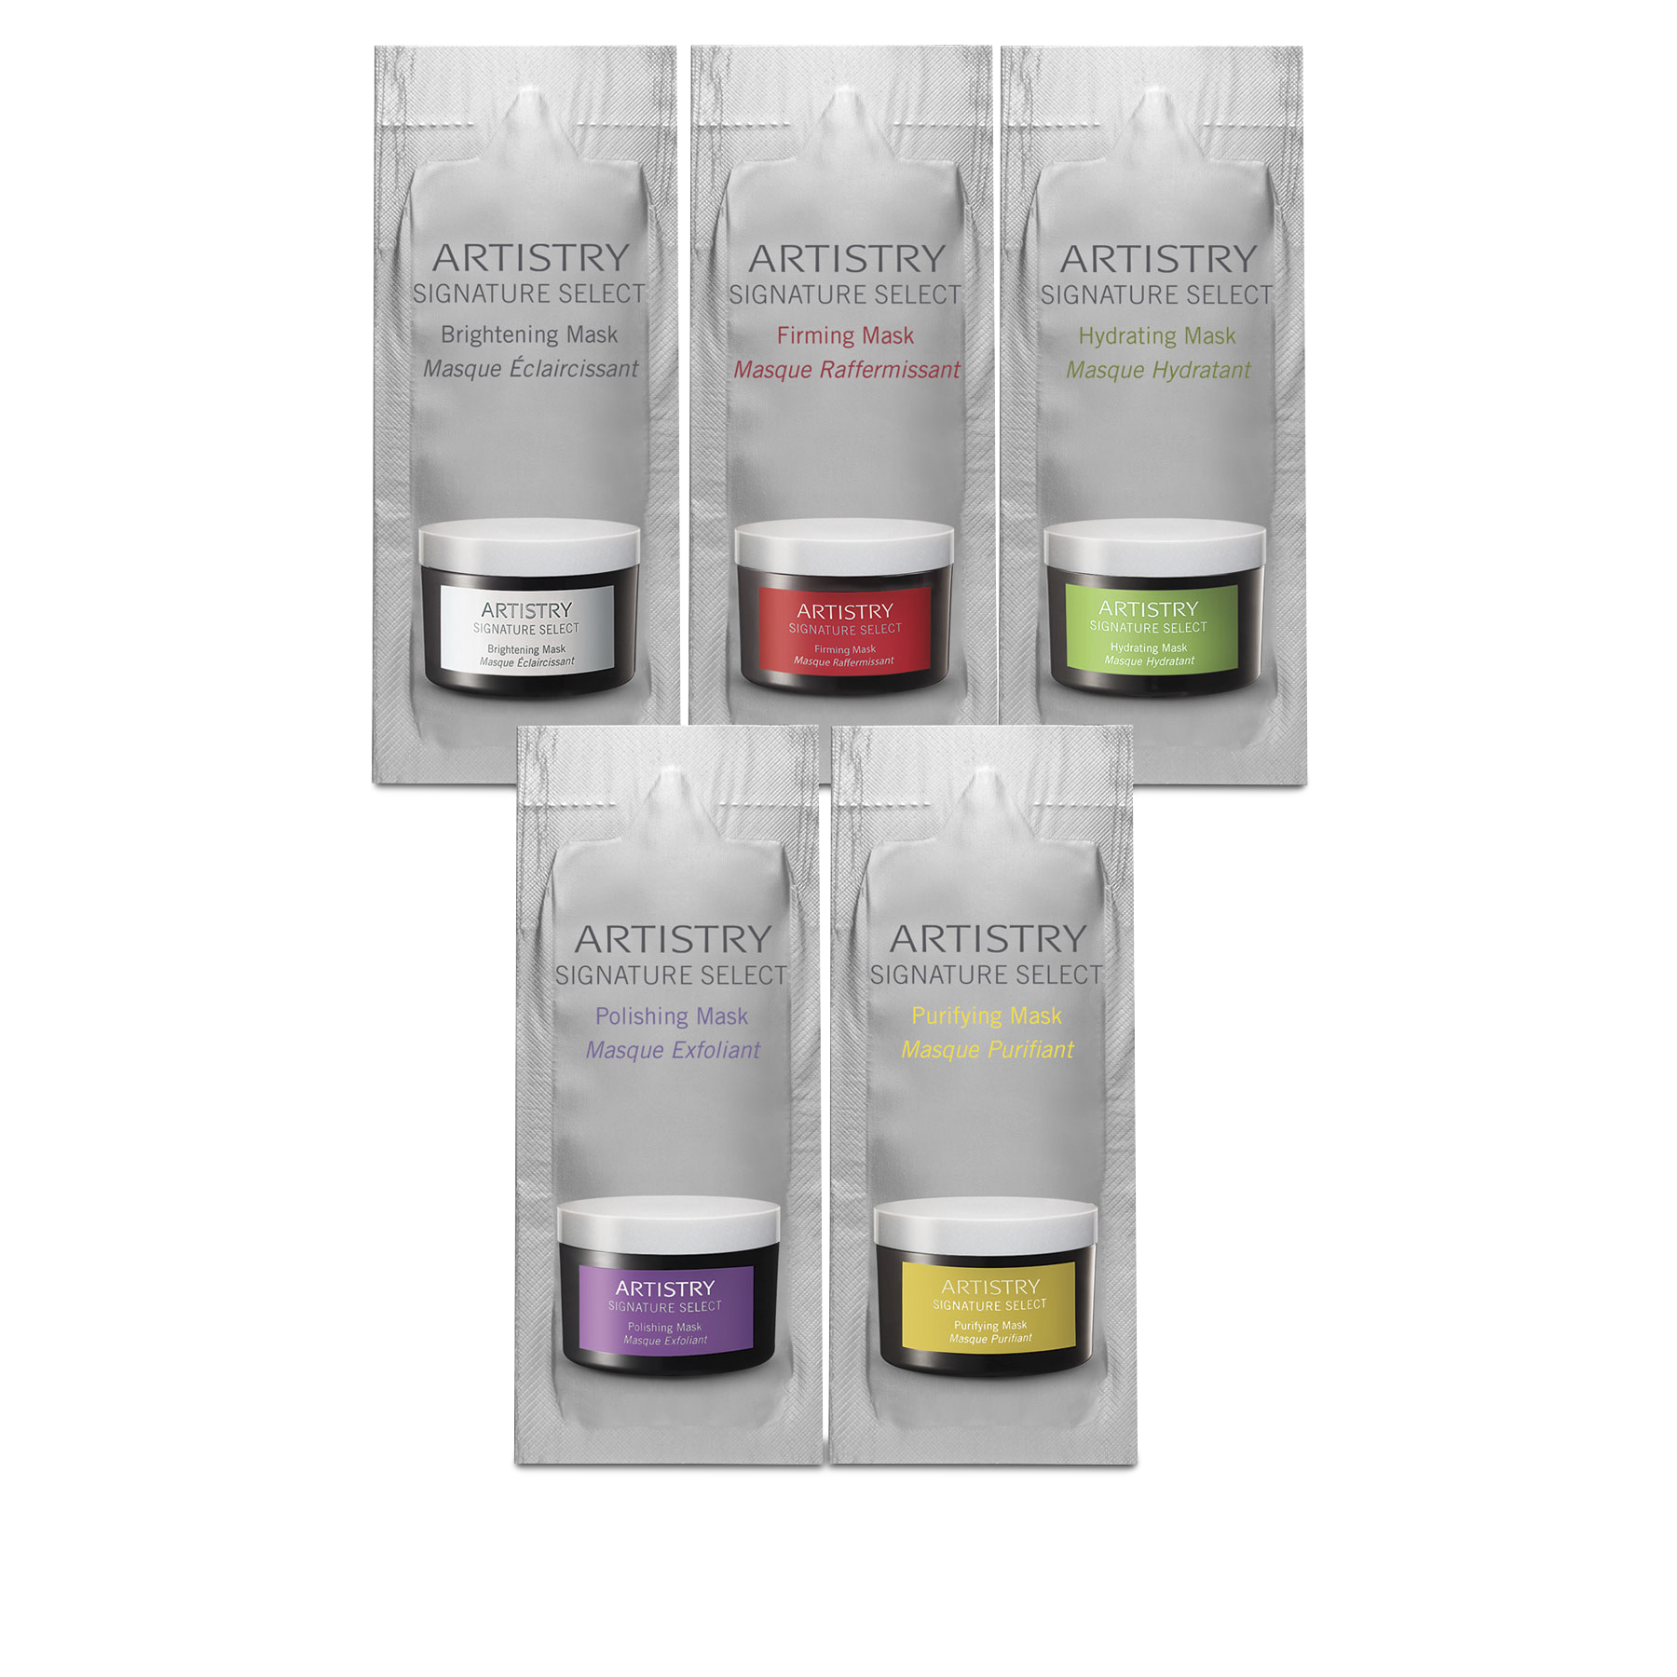
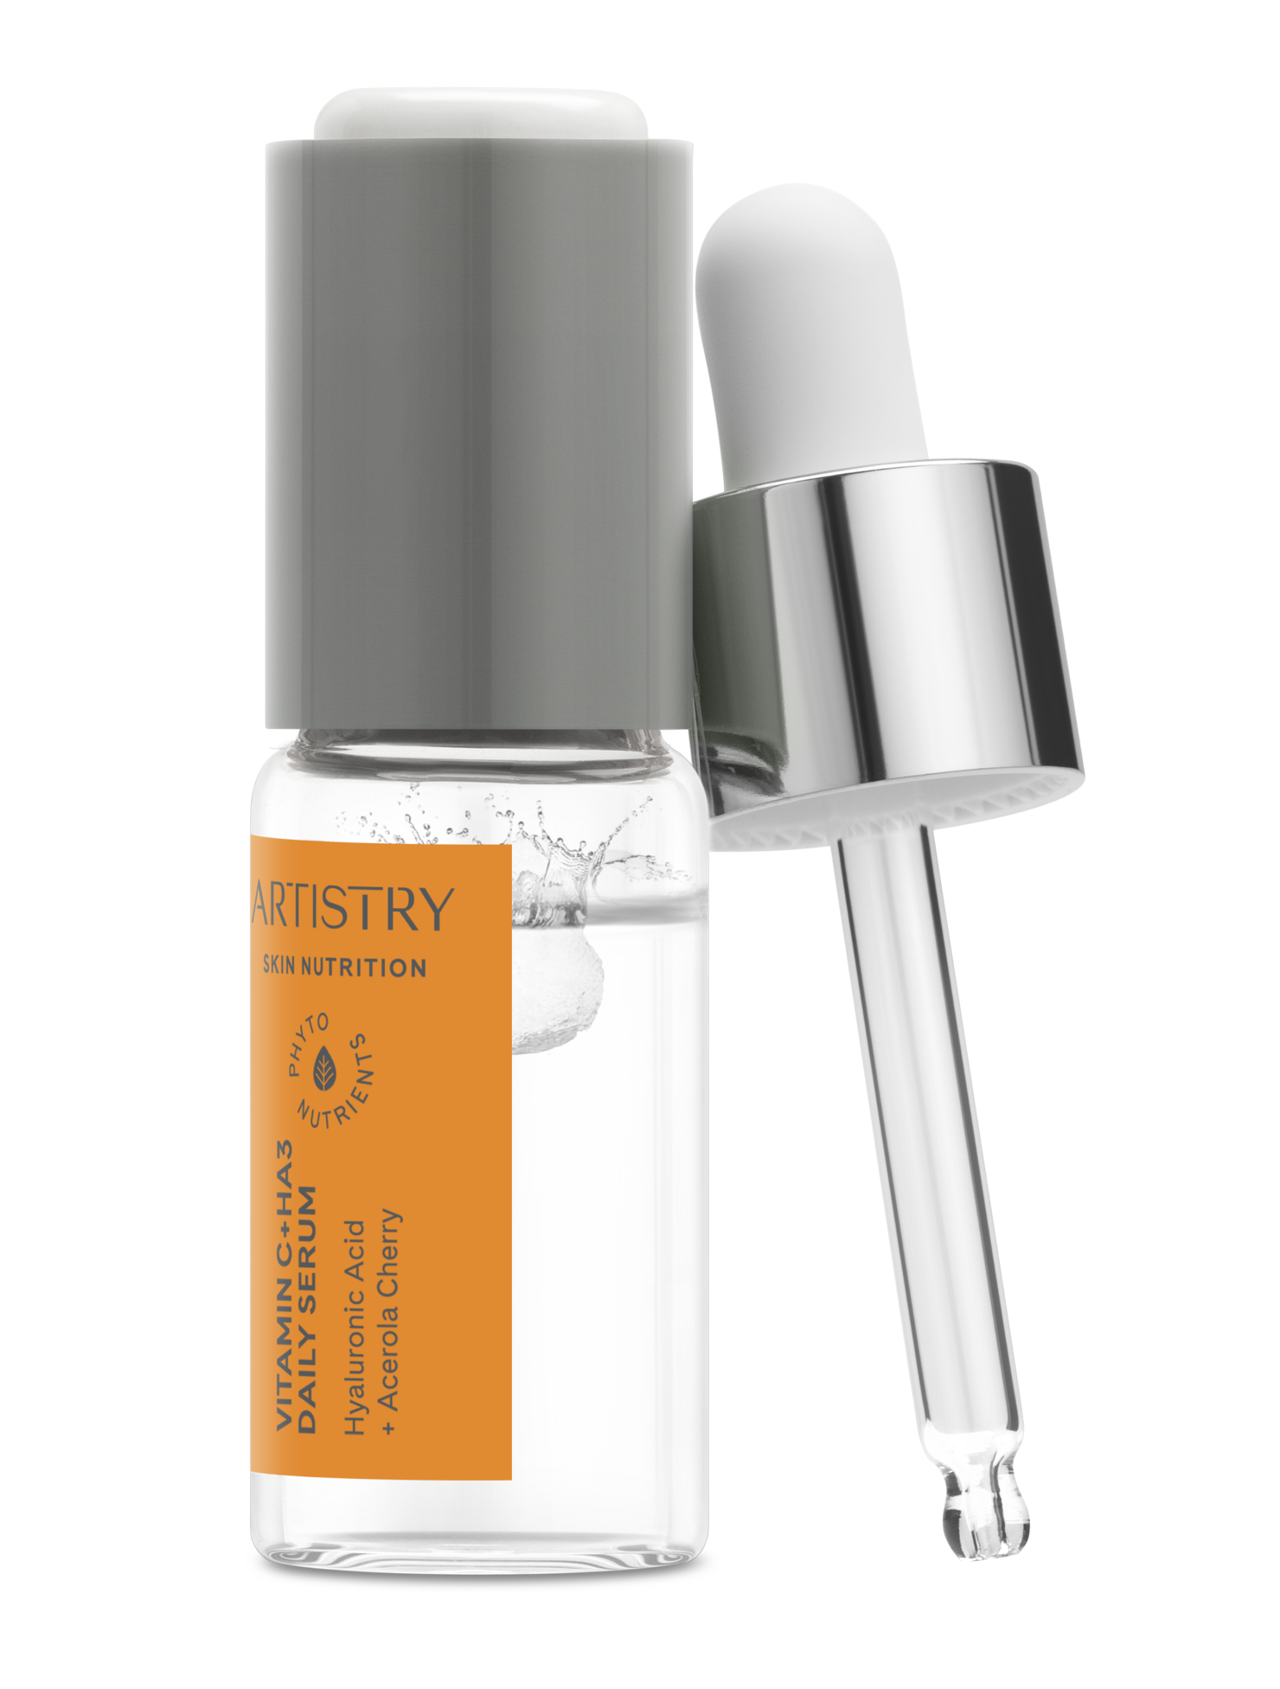
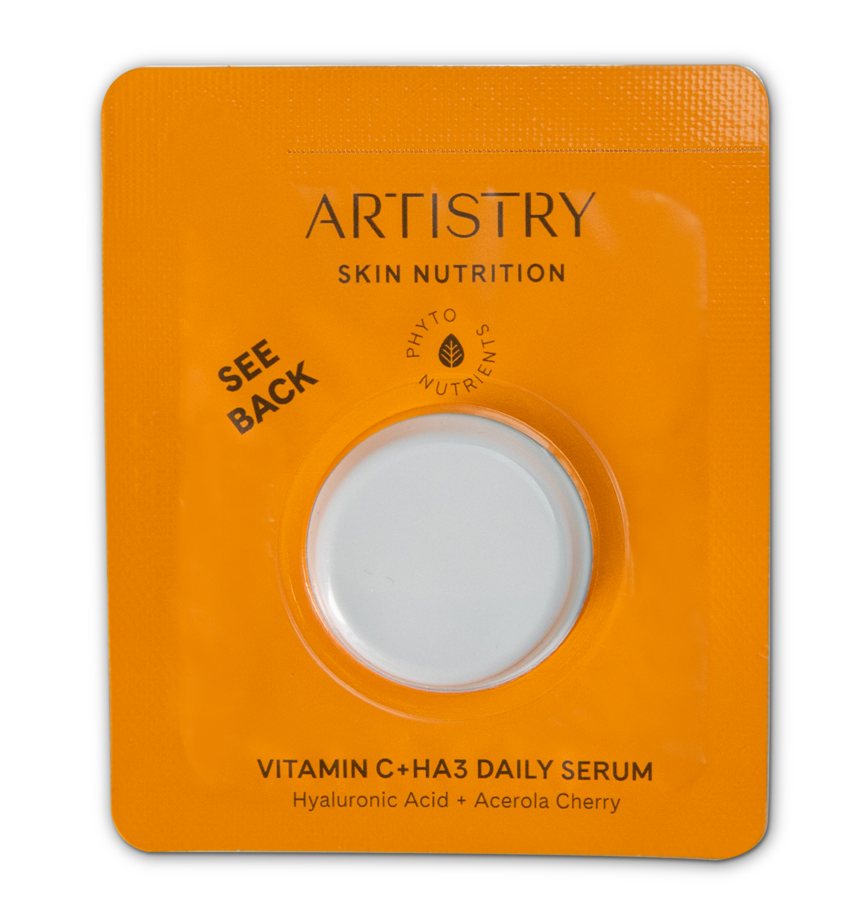
Benefits of sampling
^{81%}
of people say sampling
Sampling has a
Sampling helps
is more effective
25-30%
build loyalty
than other marketing tactics.*
to your business.
conversion rate.†
*“New Report: Consumers Want Free Samples, Wherever and Whenever They Can Get Them.” Advantage Solutions, 14 Feb. 2022
†“The Psychology of Free: Does Giving Free Samples Increase Sales?” Lightspeed, 1 June 2023
See our full selection of samples on the Amway website.
For existing IBOs ONLY. Not for use with prospects.
Notes:
Why sampling? There are three HUGE reasons why:
81% of people say sampling is more effective than other marketing tactics.
Sampling has a 25-30% conversion rate, meaning 25-30% of customers who try a sample make a purchase.
And sampling helps build loyalty to your business!
So just think, the more samples you offer that are just right for your customers, the more sales you could score!
It’s an easy and effective way to make a connection with a potential customer and give them a positive experience with your business.

Slide 3
Add sampling to your selling strategy in three easy steps!
1
2
3
Identify customer needs and offer samples that they’ll love. Be sure to share product benefits!
Follow up to learn about their experience and share your own product testimonial.
Help customer place an order that qualifies as VCS after using their free samples.
PRO TIPS:
Ask how they’d like you to contact them, so, they expect a text, email or call from you soon!
Make this a unique experience with sample bags.
See our full selection of samples on the Amway website.
For existing IBOs ONLY. Not for use with prospects.
Notes:
So, how do you build sampling into your business? Follow this simple, three-step strategy.
Identify the specific needs and interests of your customer and pick a product that meets a need. Make sure to share the product’s benefits. Then, give them a sample! You can purchase samples on the Amway website. Pro Tip: ask how they want to be contacted (email, text, call) so that they know to expect to hear from you soon!
After they’ve used their sample, follow up to ask how they liked the product. You can share a bit of your testimony too to build trust. Don’t forget that all claims, benefits and testimonials need to be approved by Amway.
Then, help them place an order and check out with their unique, valid mobile phone number so you can score VCS!

Slide 4
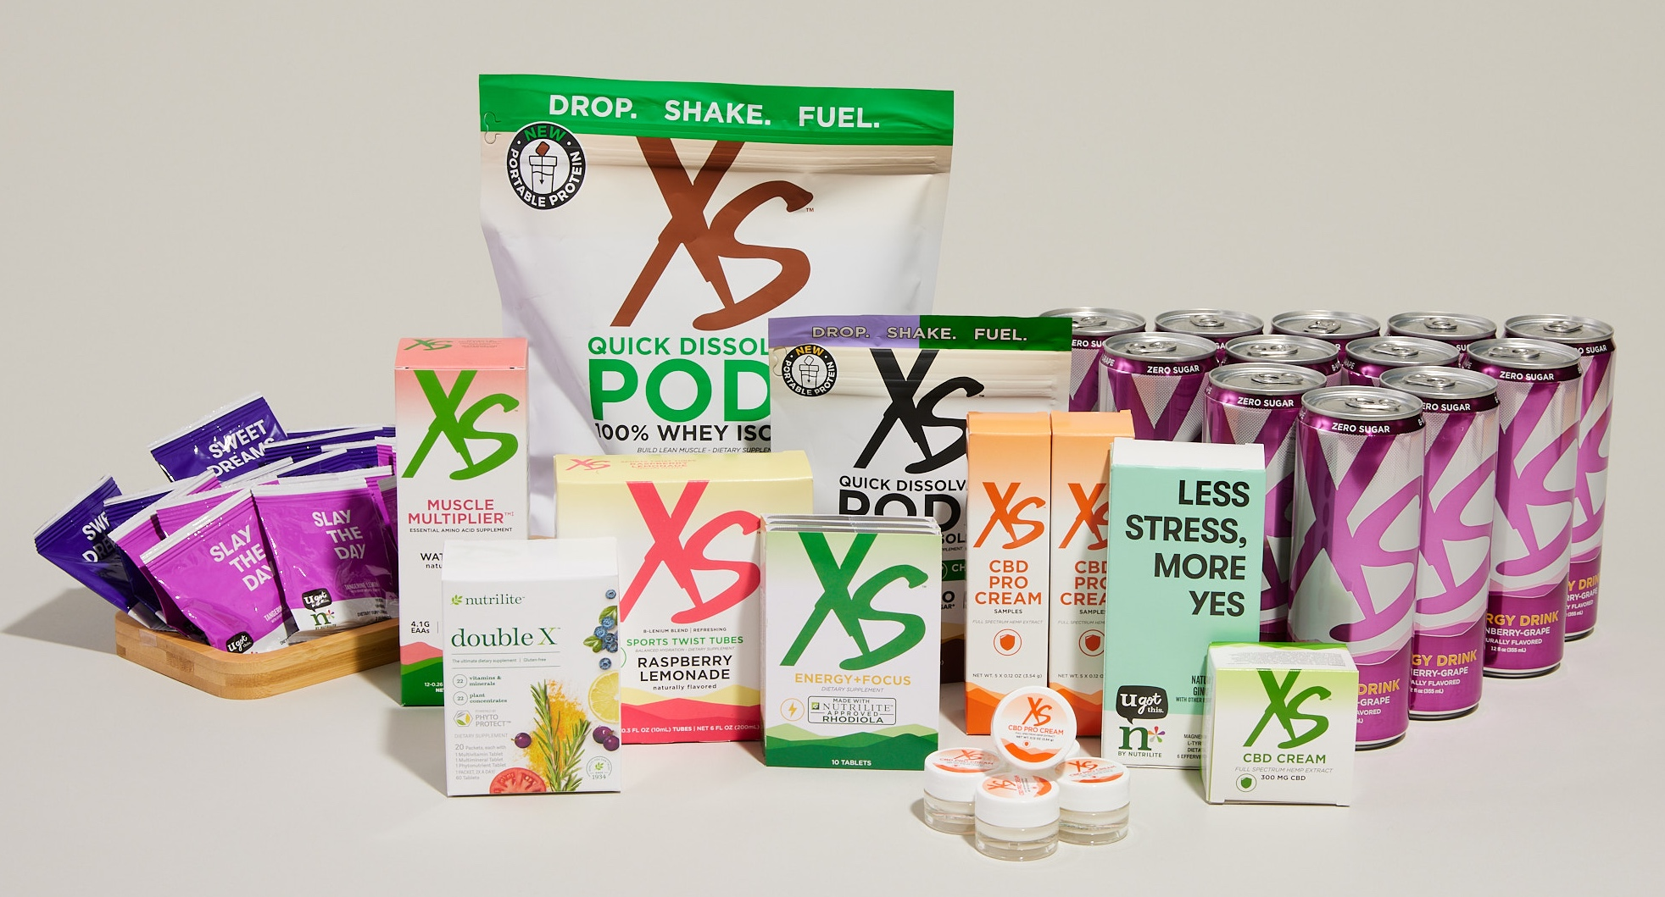
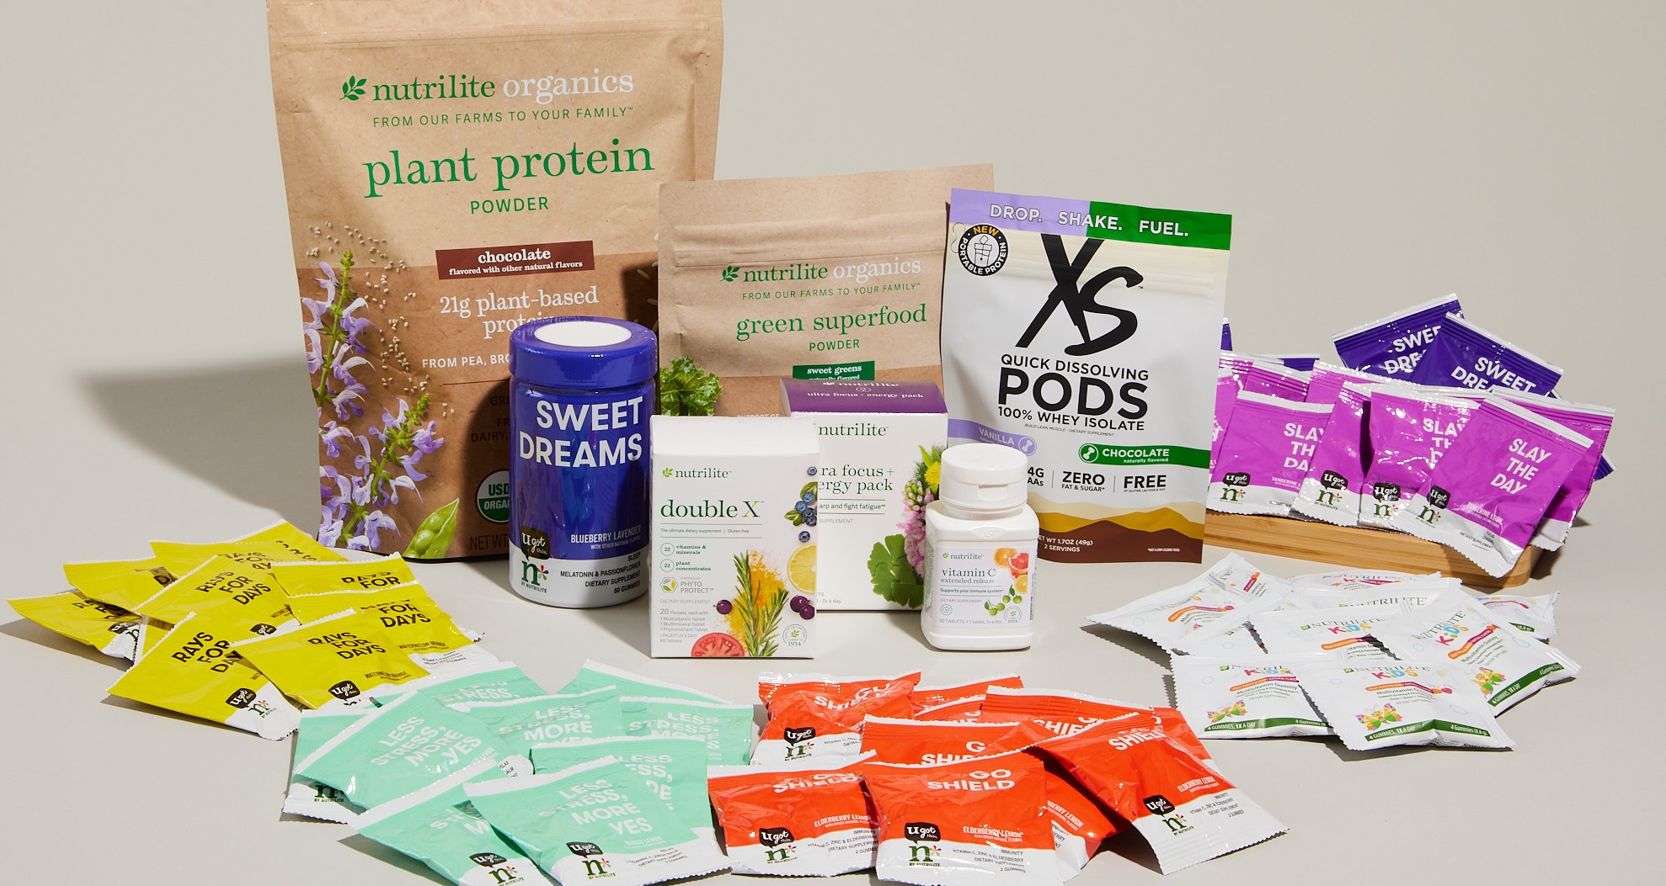
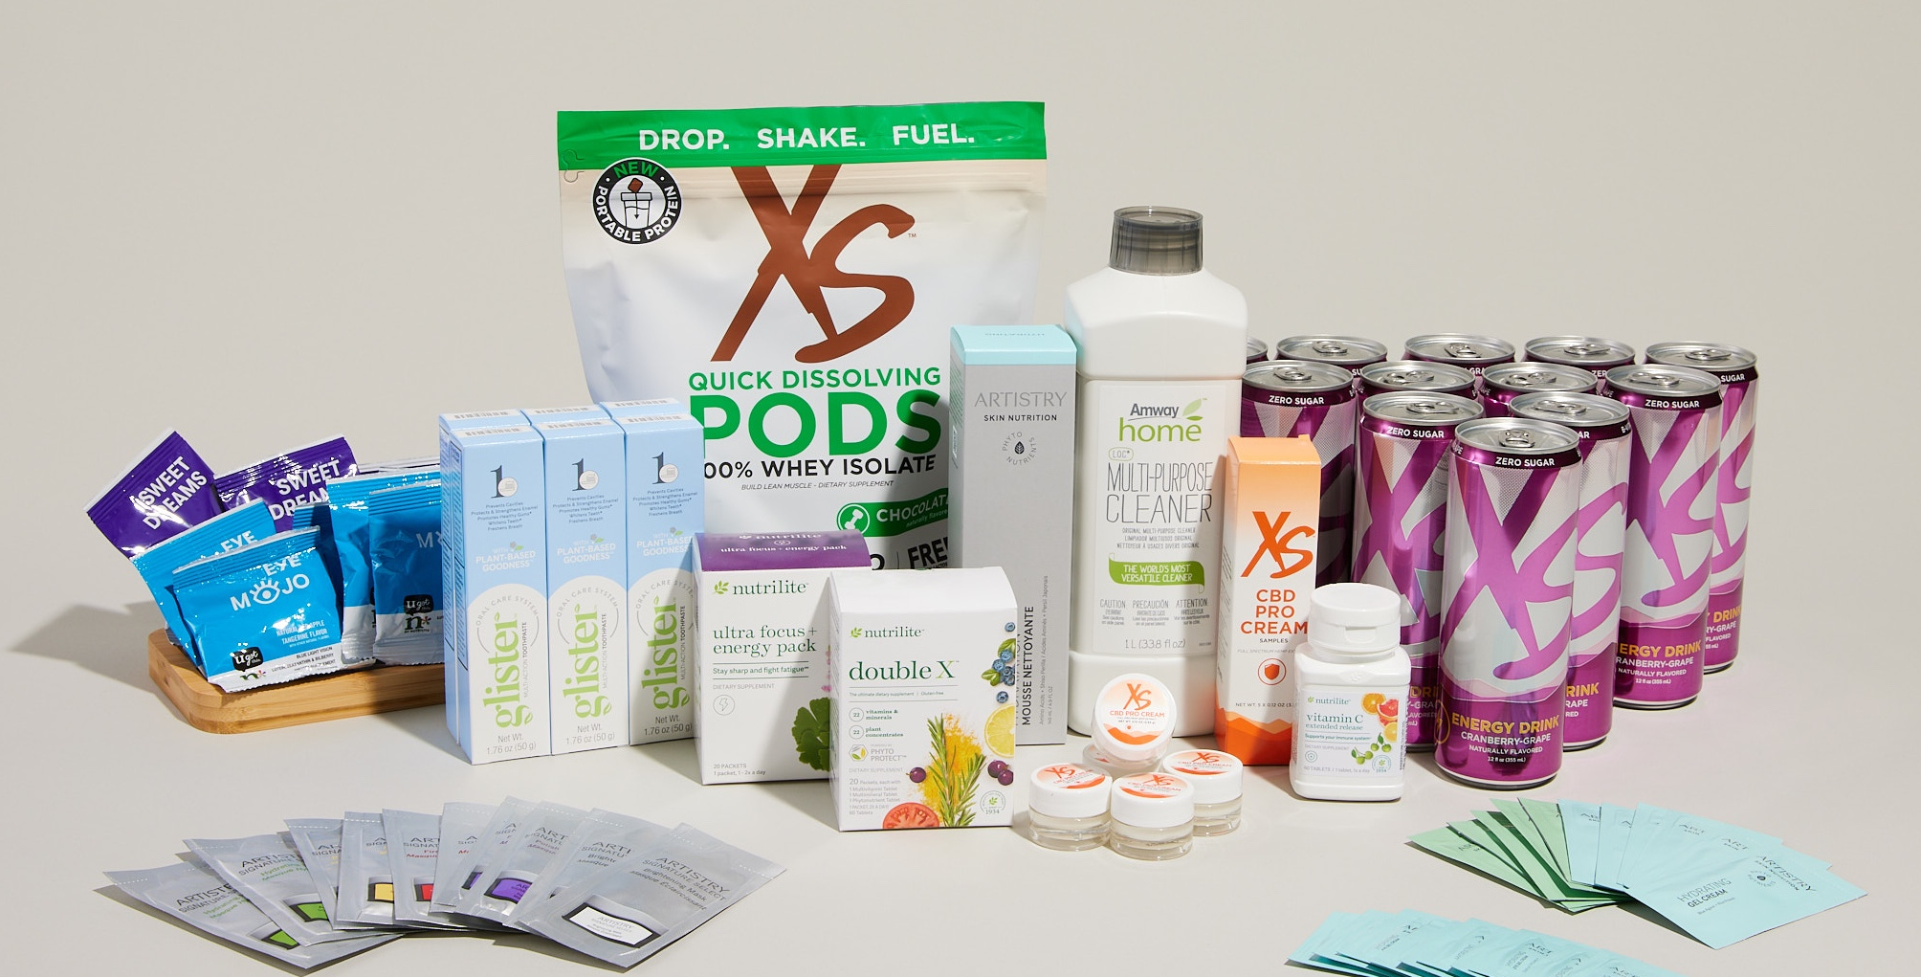
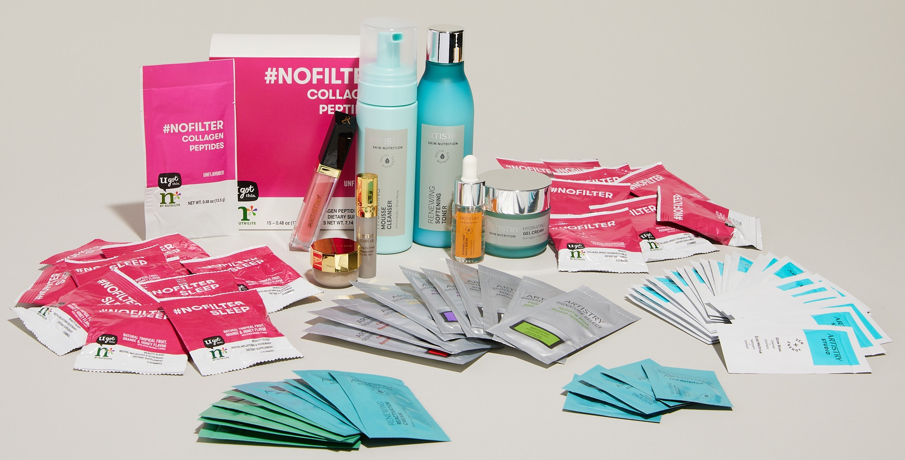
$30
$30
worth of samples!
SPORTS NUTRITION
NUTRITION
worth of samples!
Sampling with New IBO Starter Stacks*
$30
$50
Each comes with DOZENS of free samples when ordered within the first 30 days of business.
worth of samples!
worth of samples!
CUSTOMER FAVES
BEAUTY
*New IBO Starter Stacks are optional.
See our full selection of samples on the Amway website.
For existing IBOs ONLY. Not for use with prospects.
Notes:
The sooner you put sampling into practice, the better! Start right from registration by ordering a New IBO Starter Stack.
These four totally customizable Starter Stacks each come with best-selling health and wellness products that can be sold for VCS. They also come with TONS of free samples—an average value of over $30—when ordered in the first 30 days of business.
It’s a great way to learn about the products you’re most interested in, start building a testimony, start selling and, you guessed it, sampling!

Slide 5
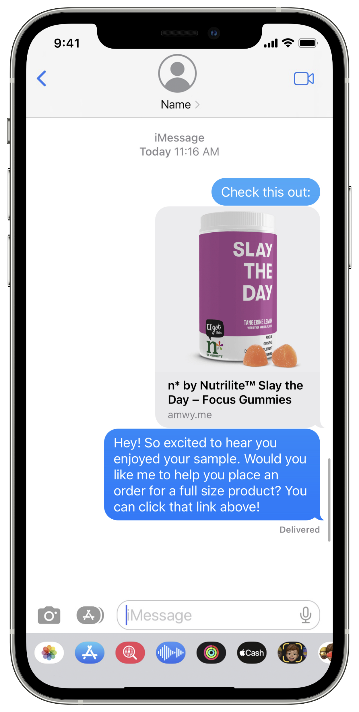
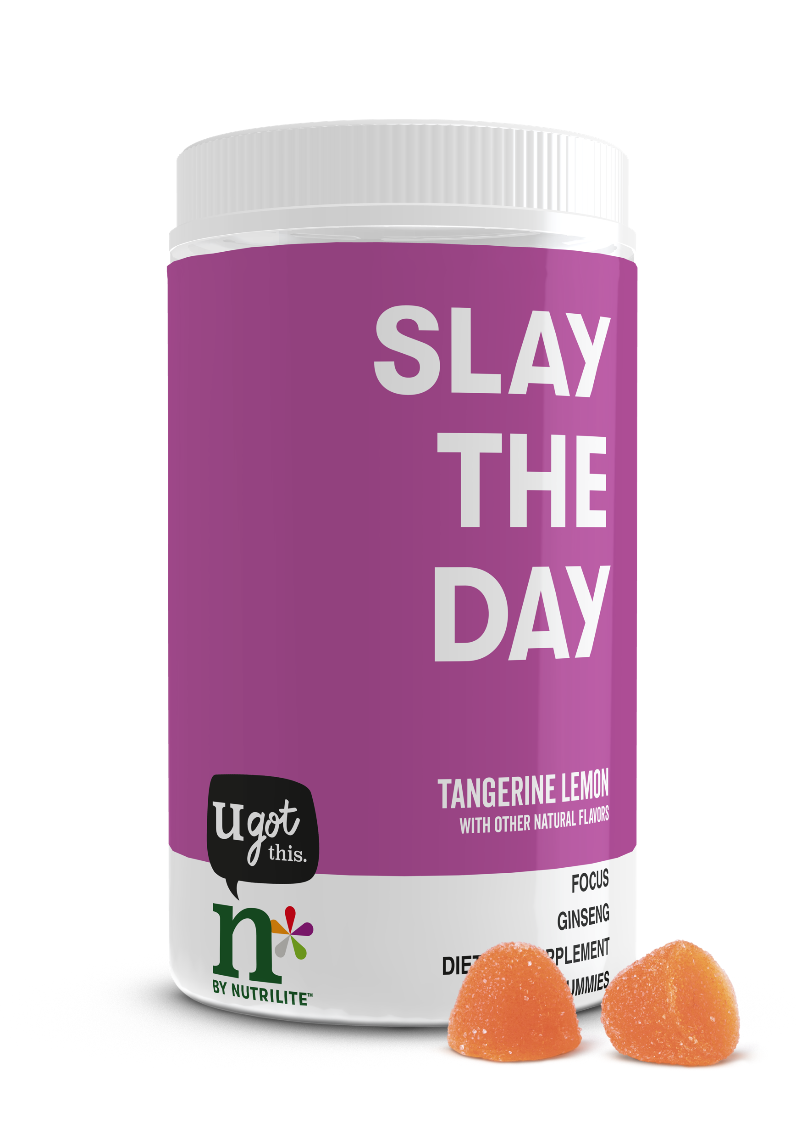
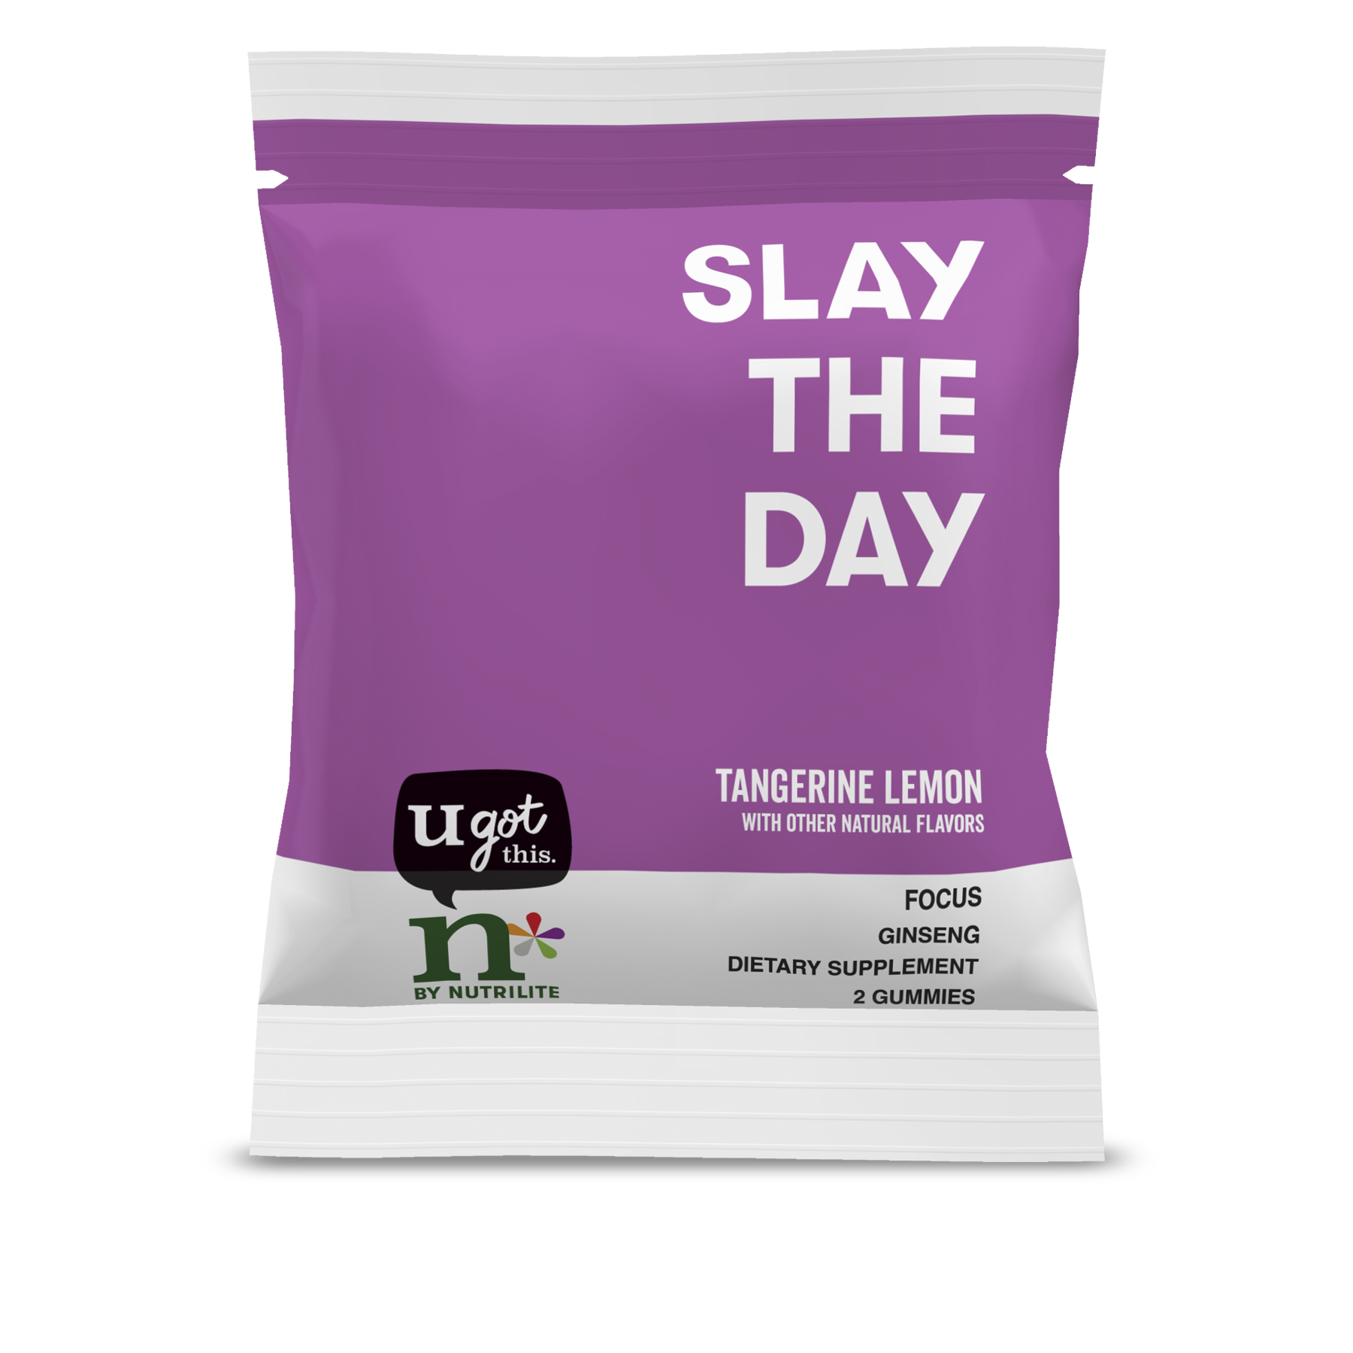
Practicing the three-step strategy
1
2
3
Identify customer needs and offer samples that they’ll love.
Follow up using the Share Feature to see if they want to order full-size products.
Help customer place an order that qualifies as VCS after using their free samples.
See our full selection of samples on the Amway website.
For existing IBOs ONLY. Not for use with prospects.
Notes:
Let’s use the Customer Faves Starter Stack as an example of how to implement the 3-step sampling strategy.
Identify your customer’s needs: Let’s say a friend lets you know they need to be more focused at work. Offer them a sample of the n* by Nutrilite™ Slay the Day – Focus Gummies from your stack. Remember, ask them how and when they’d like to be contacted so they can expect to hear from you.
After they’ve tried their sample, follow up! Ask about their experience and see if they’d like to place an order.
Help them place an order for a full-size product with their unique, valid mobile phone number to score VCS.

Slide 6
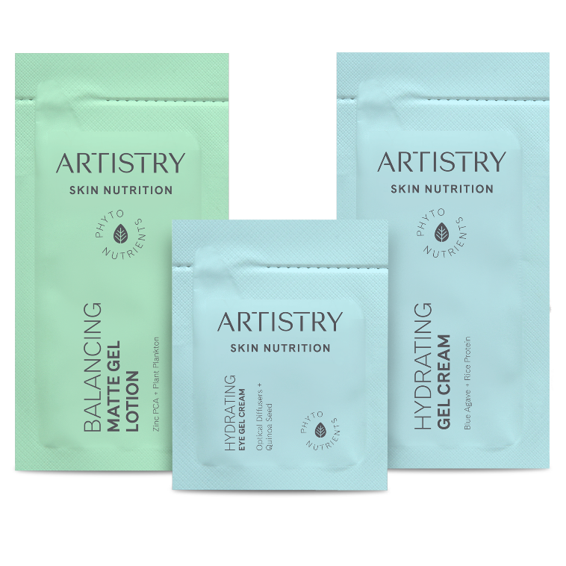
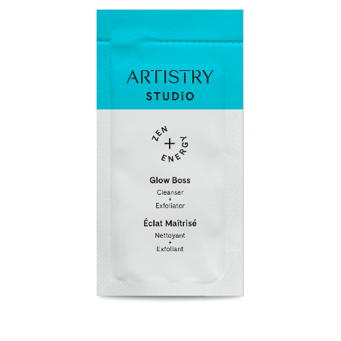
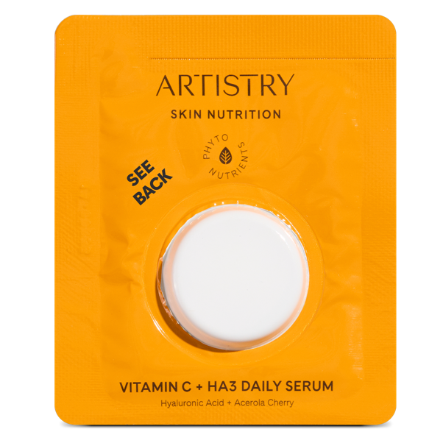
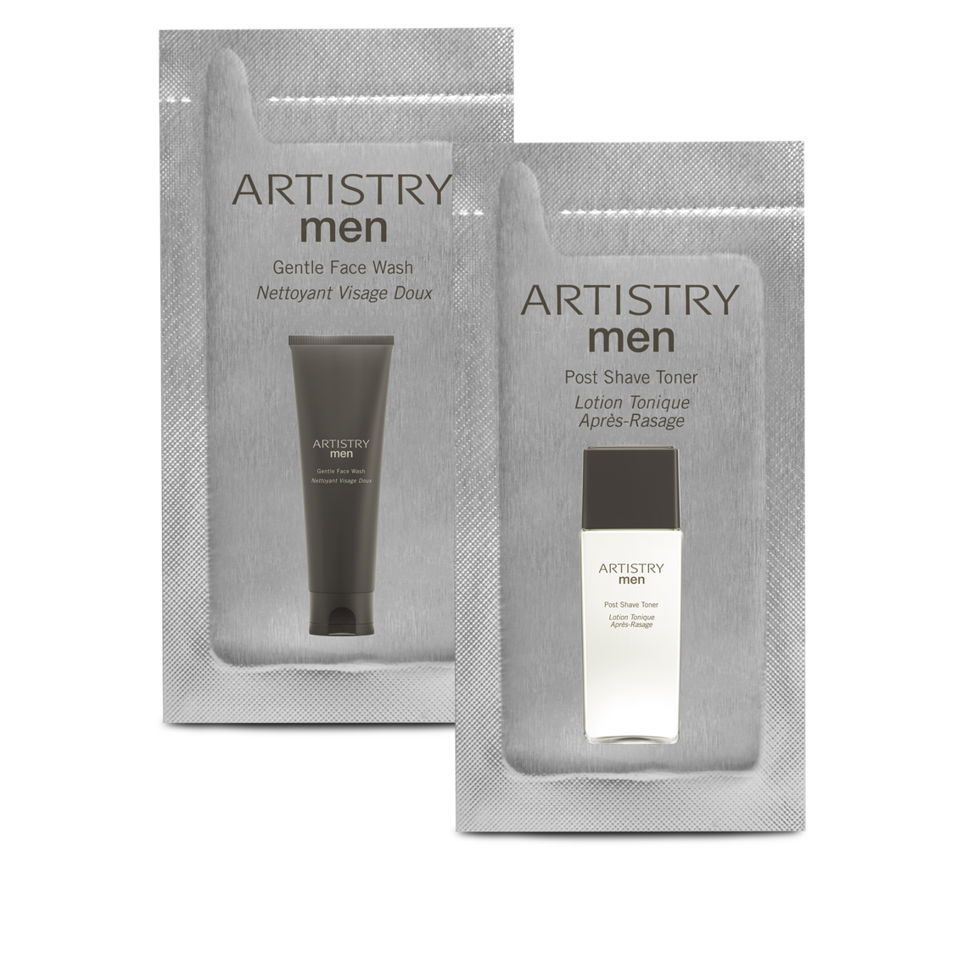
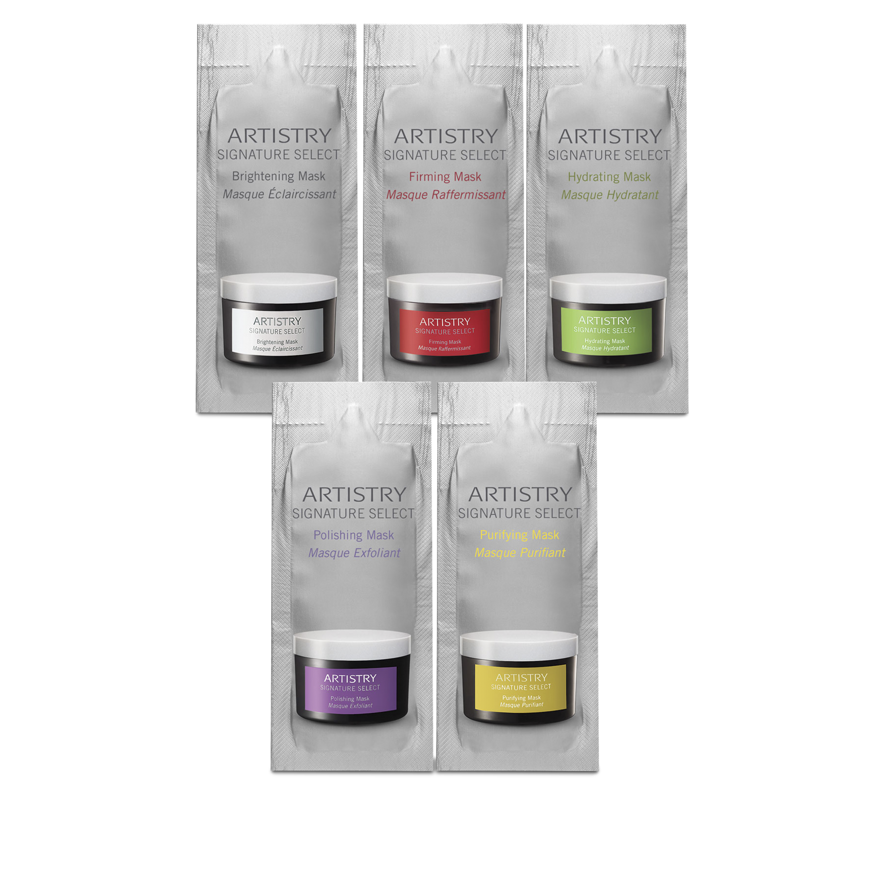
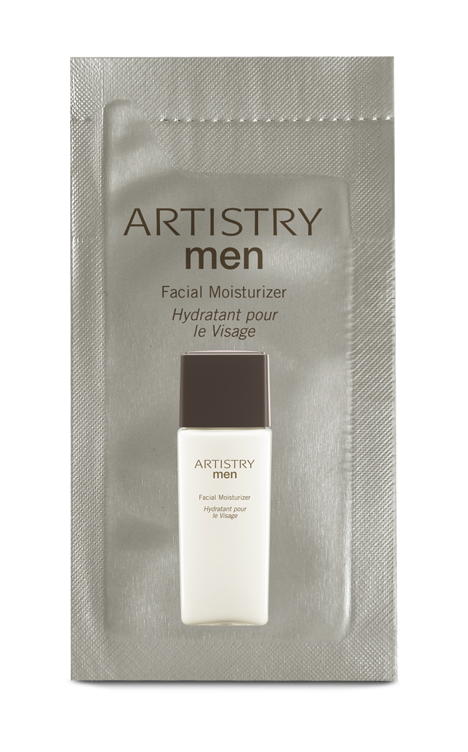
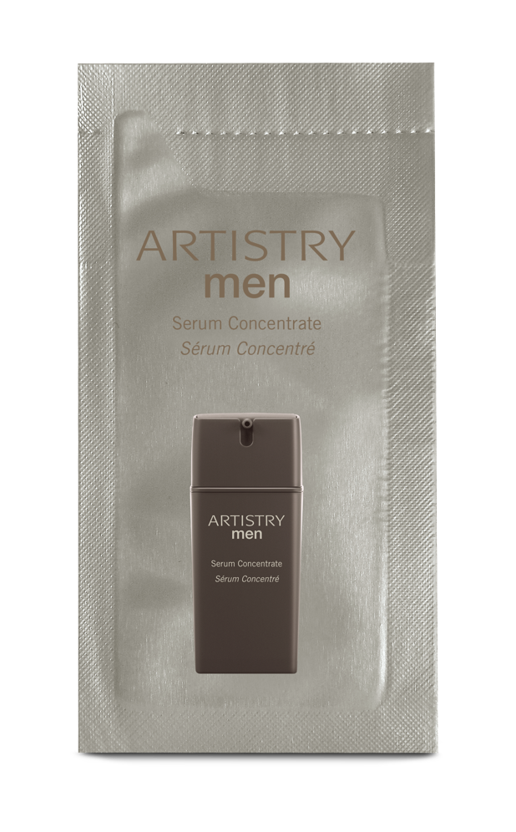
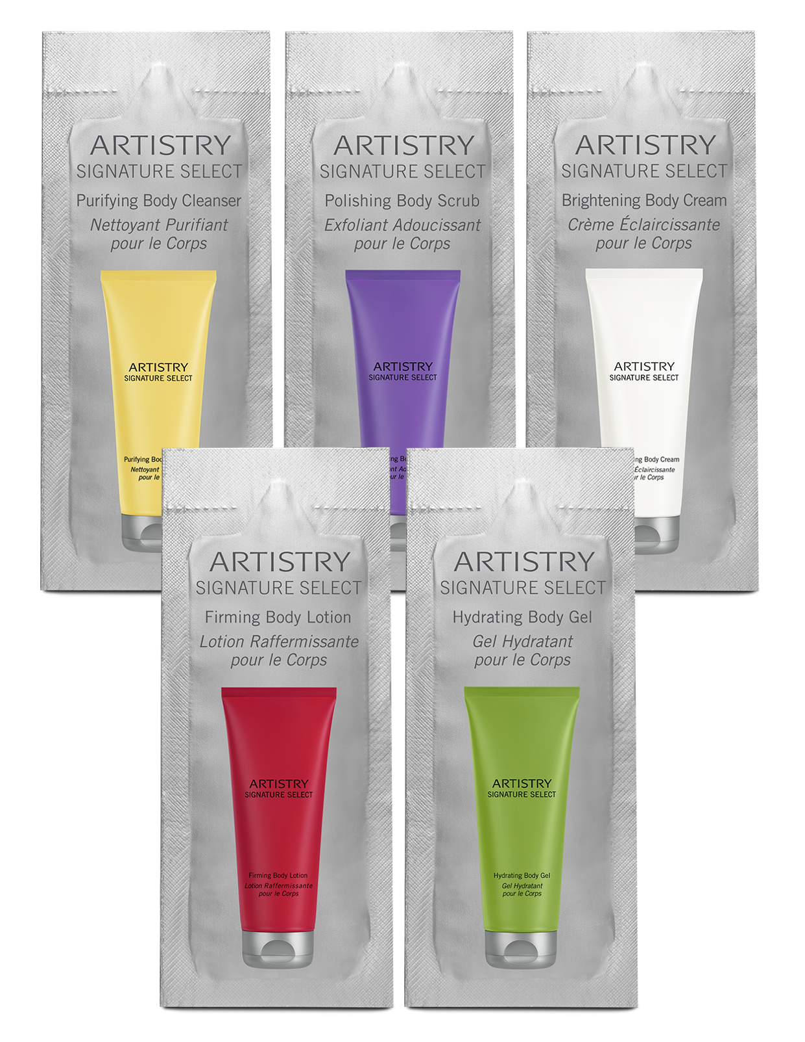
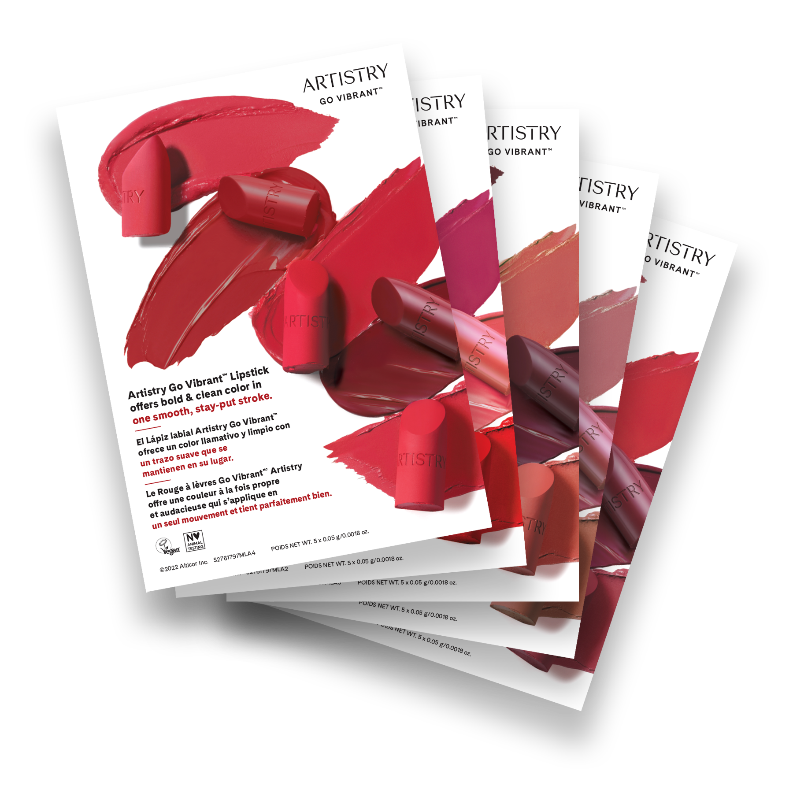
SAMPLES IN EVERY CATEGORY
Beauty
Search “samples” on the Amway website.
Notes:
In addition to the samples in the starter stacks, you can find tons of sample options across brands on the Amway website – there’s something for every customer and need! For Beauty, there are sample-size foil packets of many on-trend skin care and makeup products people are loving… like cleansers from Artistry Studio™ Skincare, body care products from Artistry Signature Select™ brand or moisturizers from Artistry Skin Nutrition™ to name just a few. These are easy to hand out to customers – and deliver results they can see and feel, like softer, glowing skin!

Slide 7
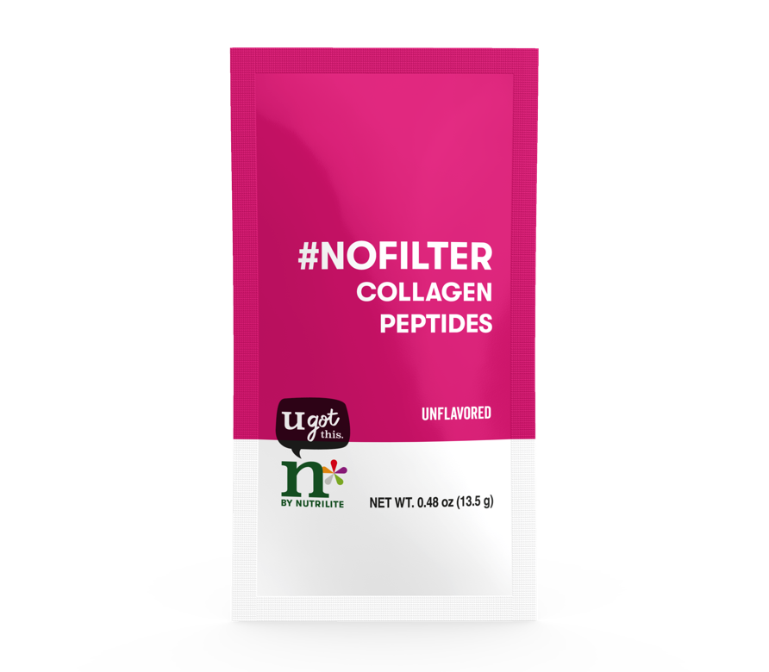
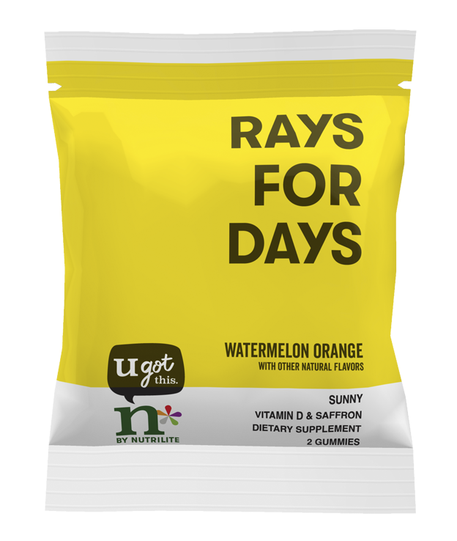
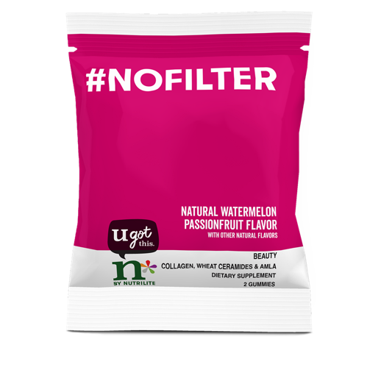
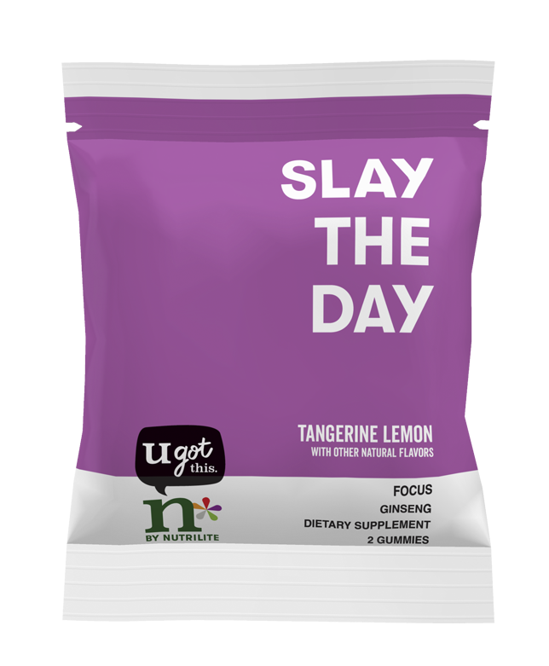
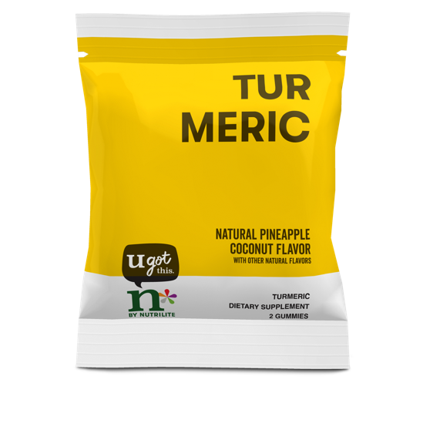
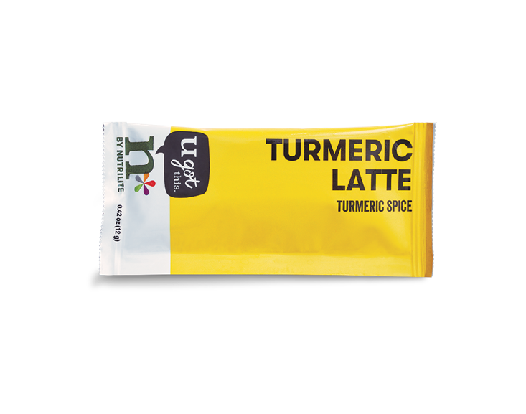
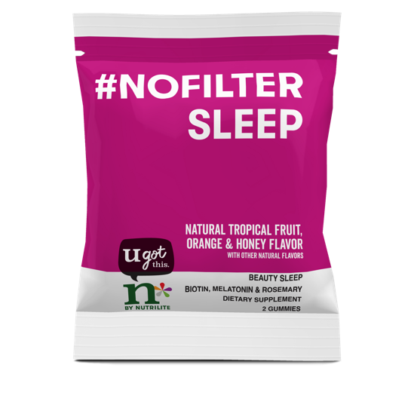
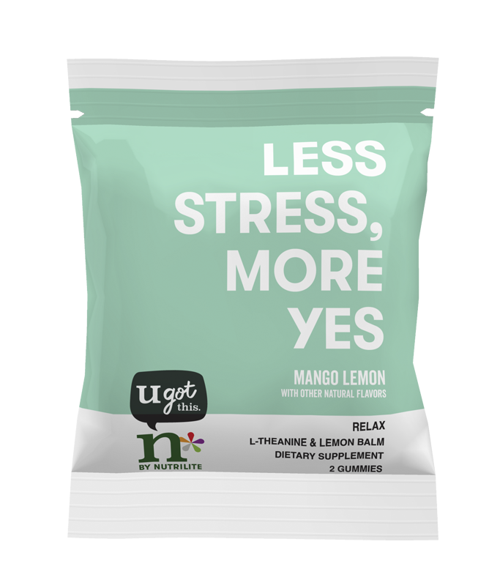
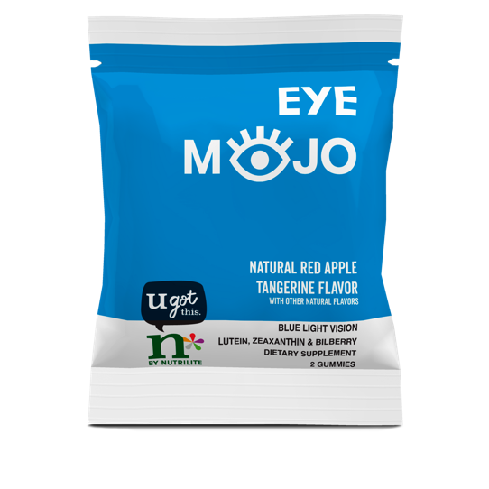
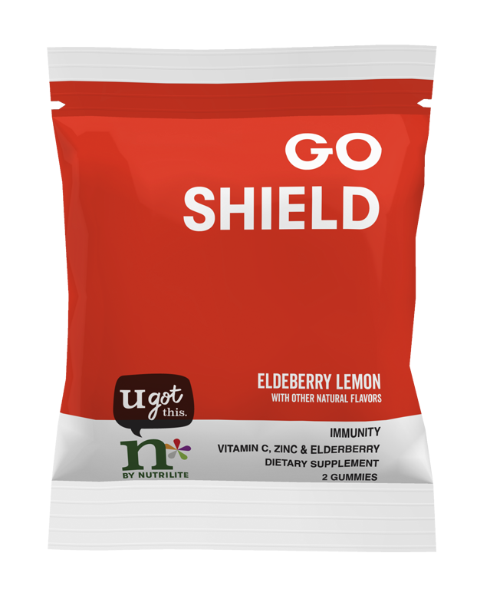
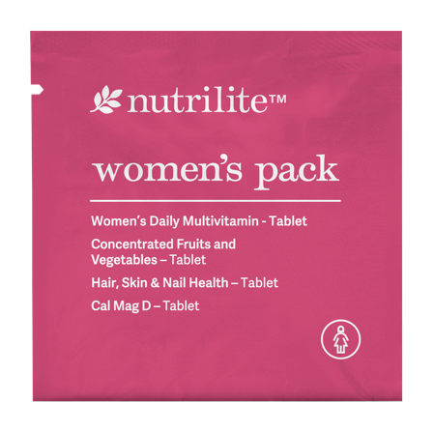
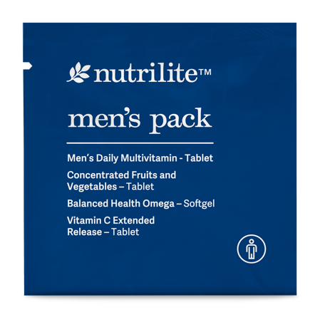
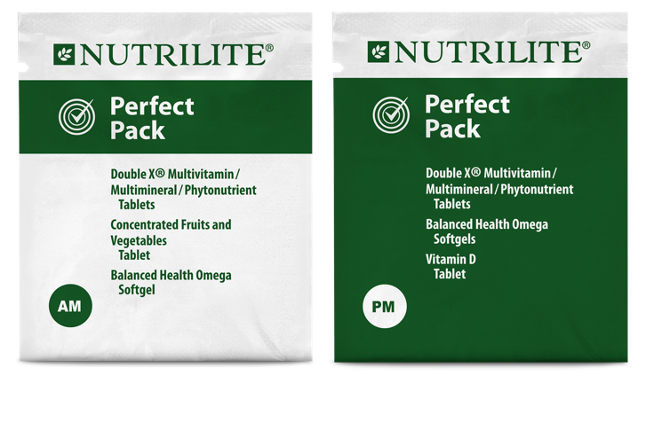
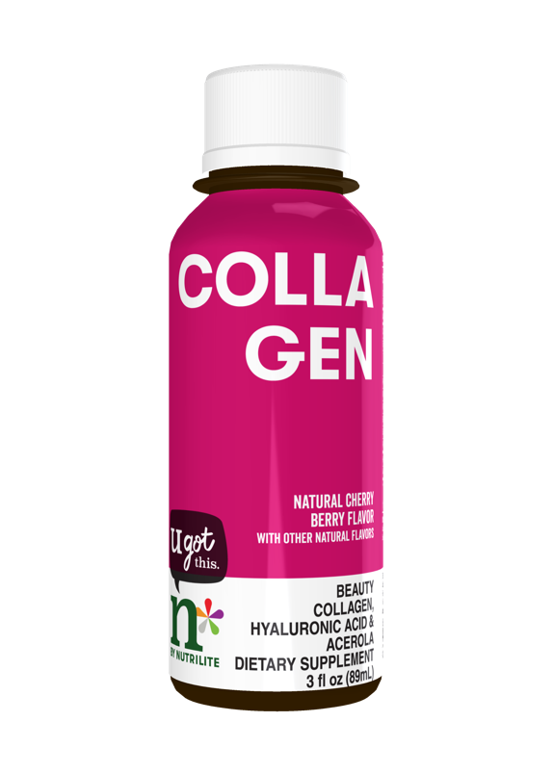
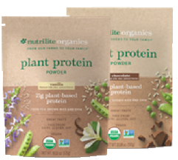
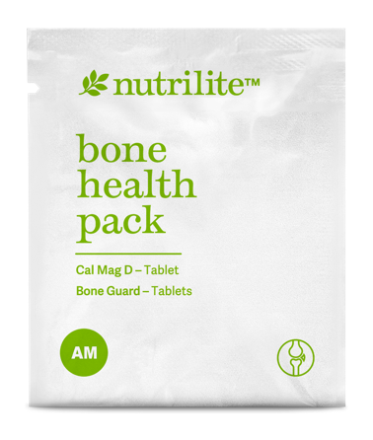
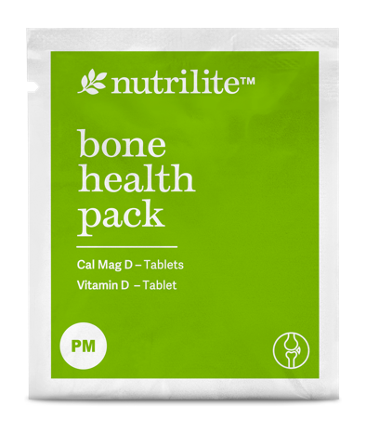
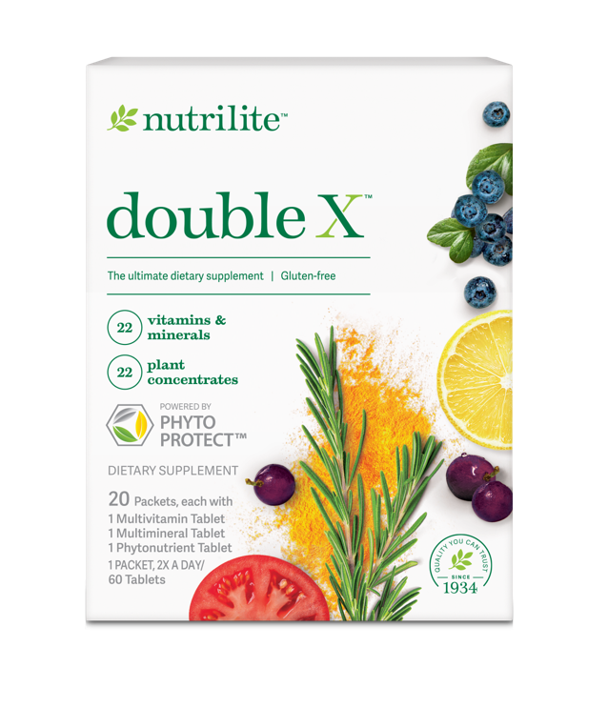
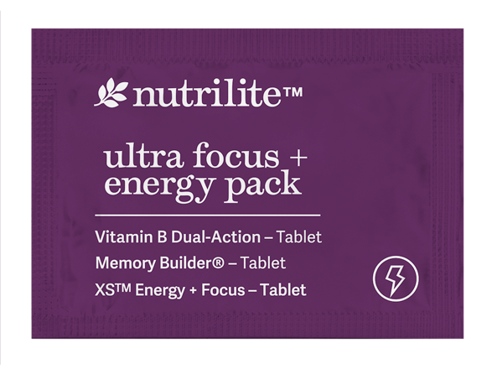
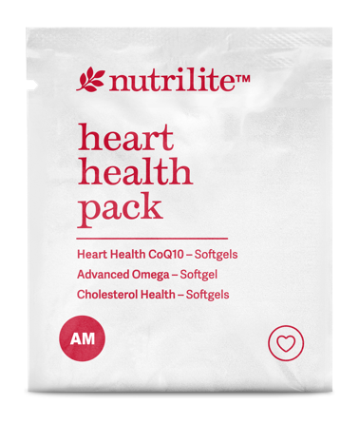
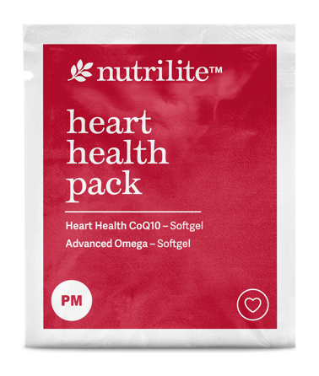
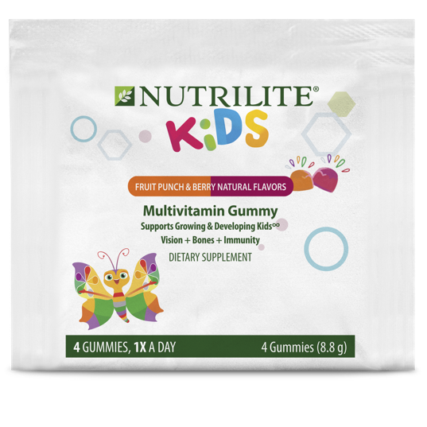
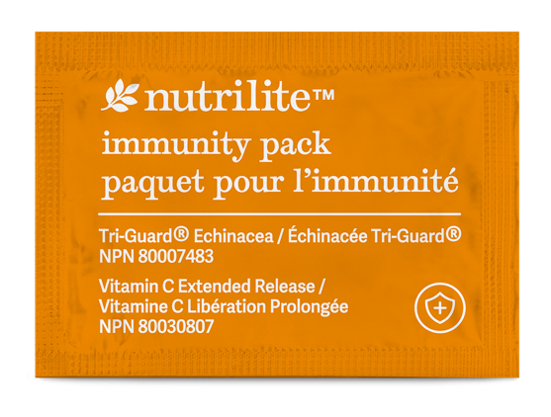
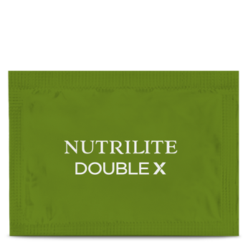
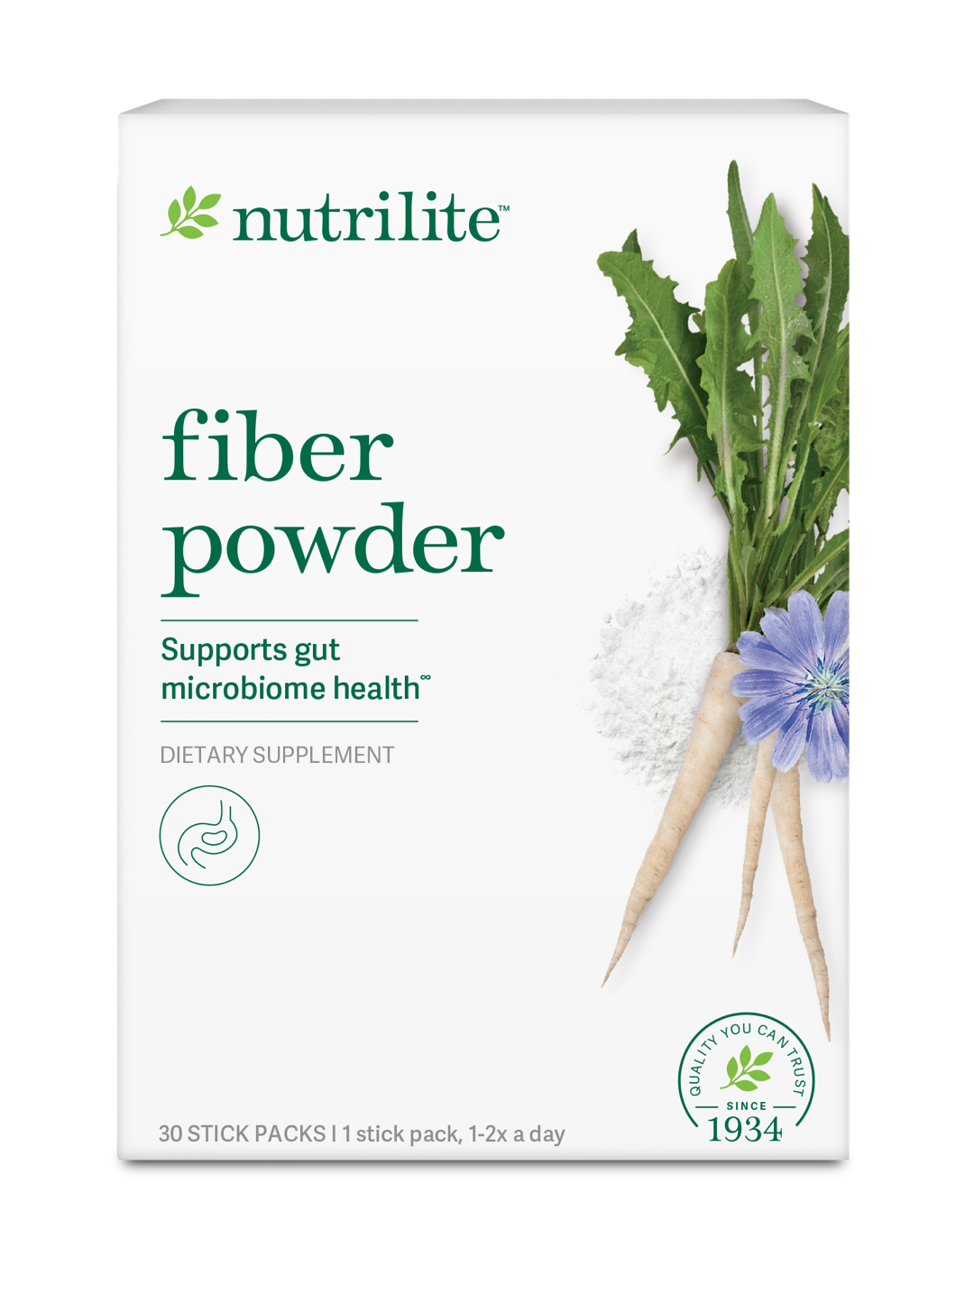
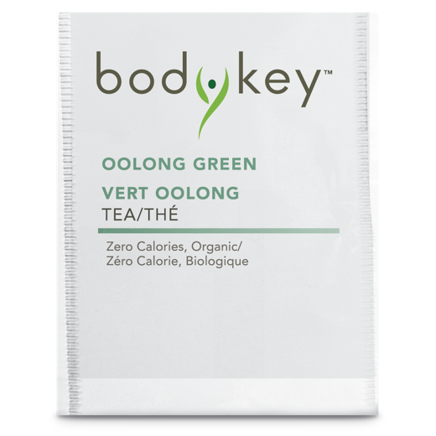
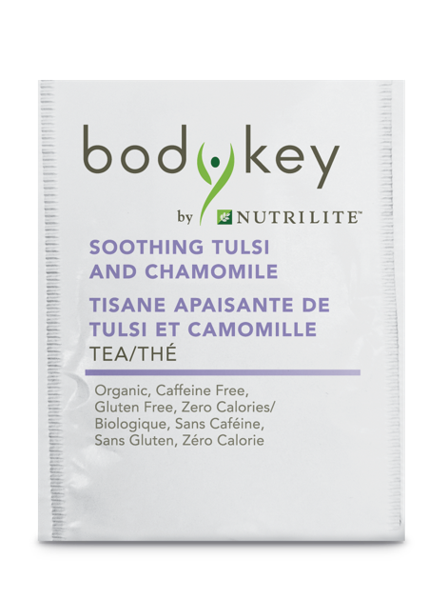
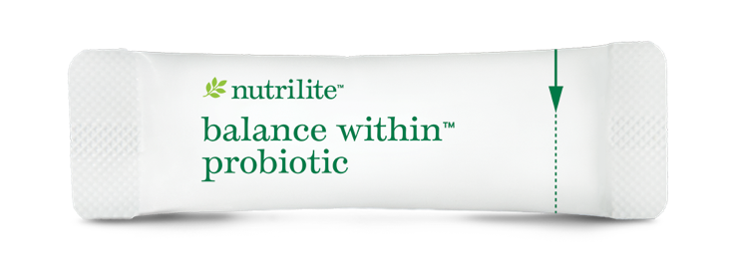
SAMPLES IN EVERY CATEGORY
Nutrition
Search “samples” on the Amway website.
Share from full-size products too!
Notes:
In Nutrition…
Many popular Nutrilite™ and n* by Nutrilite supplements come in single-sized sample pouches that are perfect to share with a customer. For men, women, kids… anyone!
Nutrilite snacks make great samples too. A customer can taste products to find their favorites.

Slide 8
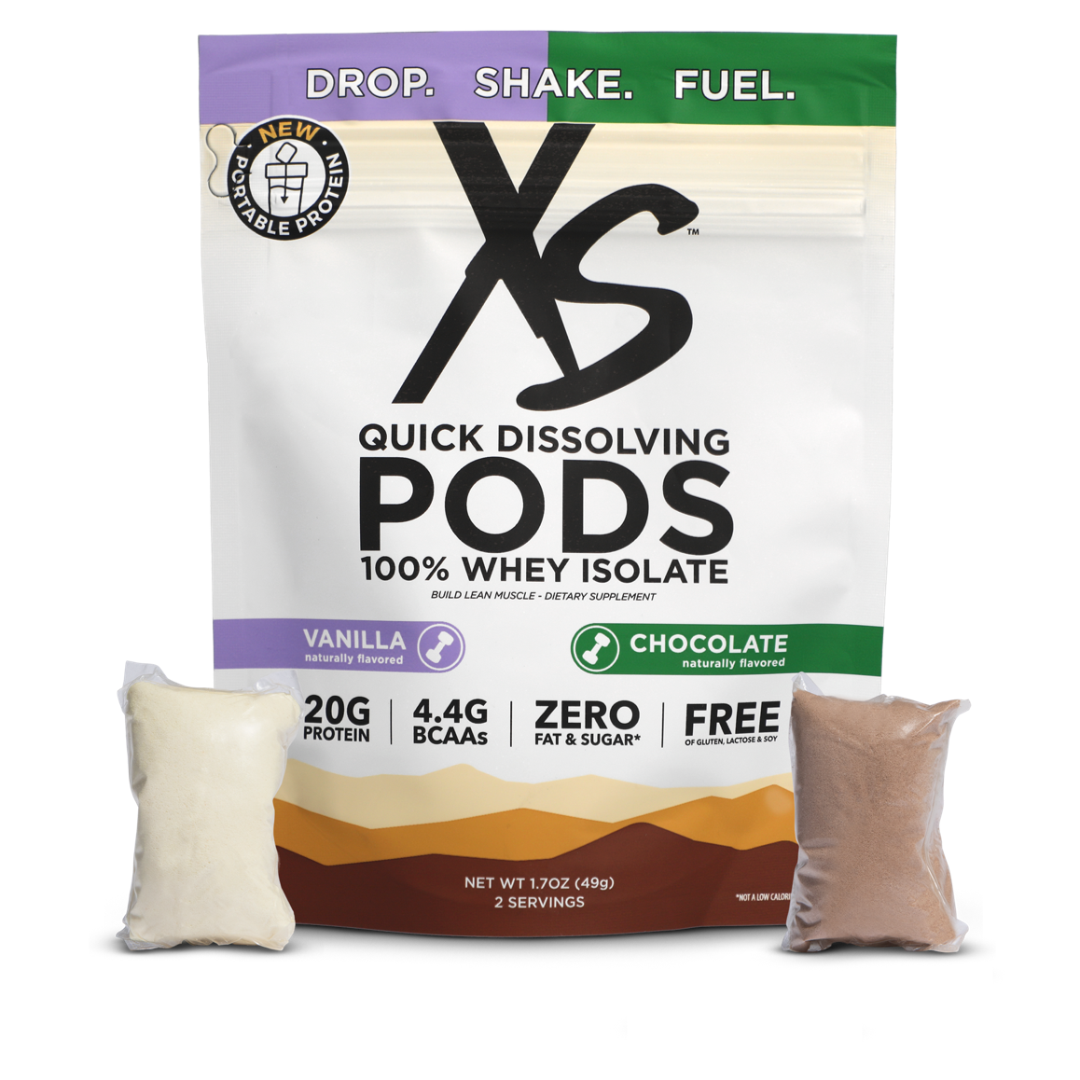
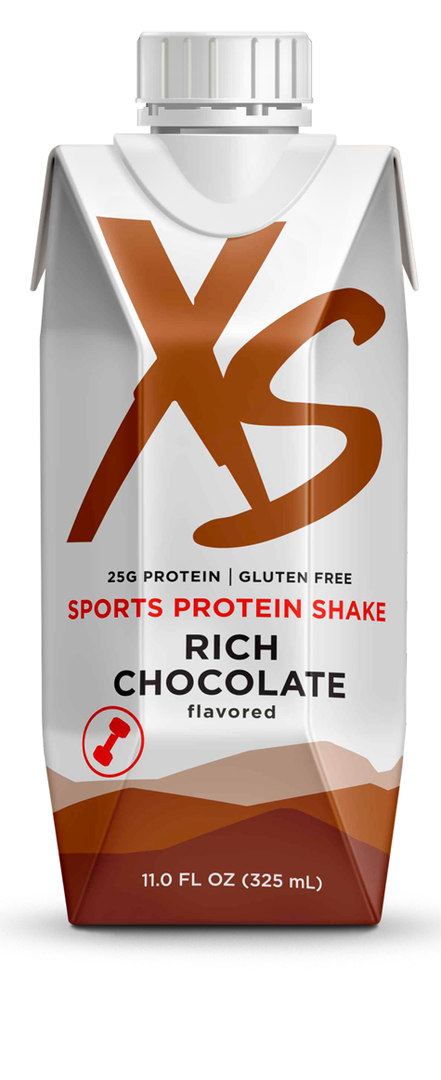
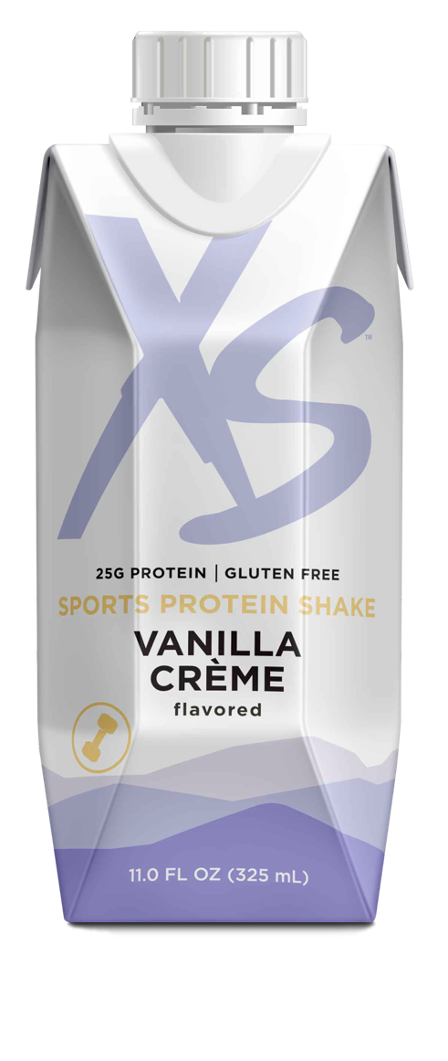
SAMPLES IN EVERY CATEGORY
Sports Nutrition
Search “samples” on the Amway website.
Notes:
In Sports Nutrition…
You all know how amazing XS™ Energy Drinks are as samples. And there are tons of other supplements, protein options and more that help customers energize, hydrate, strengthen or recover. They come in convenient packaging that makes it easy to try one and share one.

Slide 9
IDENTIFY THE NEED
Get to know your customer
PRO TIP:
Use tools like the “All About You” questionnaire to learn more about your customer. Offer samples based on their responses.
Amway.com/ ResourceCenter Search: All About You
When talking with current and potential customers, tailor your messages to their needs:
Identify the need and get them interested.
Share product suggestions and explain benefits.
Show the products and create an experience – aka sampling!
1
2
3
See our full selection of samples on the Amway website.
For existing IBOs ONLY. Not for use with prospects.
Notes:
You may be wondering: how do I know what samples my customer might enjoy? Identifying a customer’s need starts with getting to know them and making a meaningful connection. That helps you build trust, and trust makes it easier to understand a customer… and that helps them appreciate our product suggestions!
As you make a recommendation, always share why the product will fit their unique needs, and explain the benefits, like a great flavor or results they can see, taste or feel. This is the perfect time to share your own personal experience with them as well.
And then, of course, it’s all about showing them the product to create a special experience. That’s when you share a sample!
One way to get to know a customer better is to have them fill out the “All About You” questionnaire. It’s a short one-page series of questions that gets at what they may be looking for – and how your business can help. It’s available in the Resource Center!

Slide 10
IDENTIFY THE NEED
PRO TIP:
If you can’t provide physical samples, digital tools allow customers to virtually try before they buy!
Product recommenders
Digital tools can help you engage customers and improve the shopping experience.
Artistry Virtual Beauty App
Real-time assessment of user’s skin to provide personalized recommendations.
Mix and match Artistry™ makeup and beauty products to find the perfect look.
Available for iOS®† and Android.®†.
Wellness Recommender (US) Nutrition Recommender (CA, DR)
Personalized product recommendations backed by science.
Features Nutrilite™ and XS™ products.
In US, visit: wellness.amway.com.
† iOS® is a registered trademark of Cisco Technology, Inc.
Android® is a registered trademark of Google LLC.
See our full selection of samples on the Amway website.
For existing IBOs ONLY. Not for use with prospects.
Notes:
We know we can’t always be there in person to help customers identify their needs or place orders. That’s where product recommenders come in!
The Artistry Virtual Beauty App allows customers to virtually try before they buy! It has a simple quiz and a selfie-feature that shows real-time application of makeup products. It’s never been easier for customers to find the beauty products that are perfect for them.
The Wellness Recommender (US)/Nutrition Recommender (CA, DR) is a fun, simple assessment that makes product recommendations backed by science. When your customer gets a recommendation, offer a product sample!

Slide 11
IDENTIFY THE NEED
PRO TIP:
You don’t need to be an expert! Pick a page that matches your customer’s need and share it.
Needs-based selling pages
Amway.com/ wellness-needs
Everything to support a soft selling conversation and make a personal connection.
Videos
Sharable articles
Top tips
Products
See our full selection of samples on the Amway website.
For existing IBOs ONLY. Not for use with prospects.
Notes:
There are also convenient needs-based selling pages on the Amway website. These are one-stop hubs with everything you need to have a soft, friendly, authentic selling conversation and make a personal connection.
With these pages, you don’t need to be an expert! Once you start talking about a customer’s need, look at the page that matches together with your customer or share a link with them. Each page is filled with videos, tips and articles to help build their trust and confidence in you. Plus, product recommendations when they’re ready to try one out!

Slide 12
Keep customers engaged
After your customer has purchased their first full-size product, keep them engaged with digital tools like:
AmPerks
Shareable Shoppable Lists
Share Feature
MyShop
AmPerks free shipping in orders over $99 is a limited-time promotional offer.
See our full selection of samples on the Amway website.
For existing IBOs ONLY. Not for use with prospects.
Notes:
Once your customer has enjoyed their sample and ultimately made a purchase, keep them engaged! There are a number of different helpful digital tools you can use to help keep the conversation going and to score more VCS:
AmPerks: When your customer makes a purchase, make sure to help them enroll in AmPerks! They’ll earn points on every product they purchase and can redeem those points for dollars off future orders. Plus, AmPerks members get promotional, free ground shipping on orders over $99, plus double points on DITTO™ Scheduled Orders.
Shareable Shoppable Lists: Many different products can help meet your customers specific needs. You can sell them all in one easy click by creating a shareable list.
Share Feature: A top way buying customers get to the Amway website! When a customer follows a Share link, enters a unique mobile phone number and makes a purchase, those sales count as VCS and volume goes to the IBO!
MyShop: This free, personalized digital storefront helps IBOs share their health and wellness passion and recommend top products.

Slide 13
Amway.com/Education
The more you know, the easier it is to make the sale.
Start learning – and earning – with these short video courses:
Use Samples to Sell
Identify the Need
Create an Experience
Closing the Sale
See our full selection of samples on the Amway website.
For existing IBOs ONLY. Not for use with prospects.
Notes:
Want even more information on selling with samples? Head to Amway Education – it has dozens of short, engaging video courses all about building confidence and skills in selling.
Check out just a few of these courses on Amway.com/Education:
Use Samples to Sell
Identify the Need
Create an Experience
Closing the Sale

