Slide 1
Notes:
In about 20 minutes you will have all the information you need to understand our business and make the decision that’s right for you.
The business you are going to see today has a 60-year track record of success all over the world.

Slide 2
Notes:
Introduce yourself and give a brief impact statement in 60 seconds or less.
Make sure to include:
- Name
- Professional background
- Why you started your business*
- What drew you to this opportunity
*The why of the presenter will tie into things listed under “What people want today” but coming from the perspective and the personal story of the presenter

Slide 3
Notes:
Income potential
As I tell you about this business it’s important to keep in mind that this income would be in addition to whatever you’re currently doing. You can make from a few hundred dollars a month to a thousand or more. It’s up to you to decide what you want. Obviously the more you put into something, the more you will get from it. Today we are not going to talk about all the income potential, but you can follow up with whoever invited you to learn more about that.

Slide 4
Notes:
Low risk
With high earning potential you would typically expect high risk. With this business although there is high income potential, the risks are very low. Many the obstacles that you usually face when starting your own business have been eliminated.
Low Startup Cost. You don’t need to make a large financial investment. For less than $300 you will have everything you need to get started.
Experience. You don’t need to have any experience to get started. You will be equipped with everything you need to know through a coach and an education system. Of course, it’s up to you to decide if you want to take advantage of that experience and information.
Time. You don’t need to put your current income at risk because you can build this business in your free time, with total flexibility and completely self-managed. Again, the money we talk about today should be considered as an addition to your current income.
You will have the advantages of owning your own business without the worries of a traditional business, making this an ideal opportunity.

Slide 5
Notes:
World’s number 1 company in the industry
How are we able to do this? When you start your business, you will be backed by the number one company in the world in this industry(1).
This company has $7+ billion in global sales annually
Production and distribution facilities of the highest quality using the latest technology.
Research and Development in over 100 laboratories where over 1,000 scientists and specialized technicians work, guaranteeing products of the highest quality.
Calculate and pay out all the bonuses and incentives
Manufacture the highest quality products
And implement rules of conduct to ensure integrity.

Slide 6
Notes:
All of this is done by Amway. Amway has 60 years of proven success in more than 100 countries and territories around the world and has paid out over $60 billion dollars in bonuses to date.
Amway manufactures some of the world’s leading brands that we have exclusive access to build our business. Amway products focus on healthy living from the inside out. Providing products that are good for you, your family and friendly to the environment.

Slide 7
Notes:
Nutrilite is the world’s number 1 vitamin and dietary supplement brand.
And Nutrilite is the first and only global vitamin and dietary supplement brand with a USDA Organic product line to grow, harvest, and process plants on their own certified organic farms
Artistry has been in the skin care and cosmetics industry for over 50 years with an unparalleled commitment to research and development and utilizes plant-based ingredients from their own farms.
XS Sports Nutrition. A complete range of dietary supplements developed to support physical performance at every stage of training (before - during - after).

Slide 8
Notes:
Satisfaction Guarantee
Every Amway product as well as the Amway opportunity itself is covered by a satisfaction guarantee.
Any person who buys any product from Amway and is not satisfied, can return it within 180 days for an exchange or refund.
With seven plus billion dollars in global sales and a satisfaction guarantee on all those product sales it speaks to the quality of Amway products and of the value of our business.

Slide 9
Notes:
How income is generated
As an Amway business owner, you have access to all the incredible products I just mentioned. All these products have a point value – about 1 point for every $3.
To overly simplify how this works, points accumulate and at the end of the month and are calculated to a cash bonus. The more points you accumulate, the more money you can make. We will get into more detail in a minute about how exactly this is calculated. But first I’m going to tell you how points are generated.
There are three ways to create points.

Slide 10
Notes:
The first way to create points is to buy products from yourself.
You receive a 10% discount on the products you buy, and you get the points.

Slide 11
Notes:
Second way: orders by customers registered online
The second way to create points is to sell products to customers.
Your customers can order from you online and you receive 10% commission as well as the points from their purchase.
How many times have you recommended a product you like to a friend, who then also bought it. You are probably already doing this, so you might as well get paid for it.

Slide 12
Notes:
Third way: building a Network
The third way to create points is to build a Network of people who do those two things.
Let’s look at some examples of how this works.

Slide 13
Notes:
Example One
Suppose you place a personal order of 50 Points and register 4 customers online who each place a personal order of 25 Points.
Your Network consists of 1 business account, you. You have reached - in a single month - a total business volume of 150 Points (which includes all the Points generated by your customers).
In this example you get a 10% discount on your products, you also receive a 10% retail profit on each order placed by your customers.
That 150 points you have reached puts you at 3% on the Performance Bonus Scale.

Slide 14
Notes:
Example Two
In this example you don’t just have customers. By doing what we talked about in the first example with $300 in customer sales you are familiar with the products, you have a good customer base, and you have met the requirement to start sponsoring other business owners to expand your network.
Your group points are at 1050 putting you at the 12% level. In this example you would make $310.50 from your business volume plus $54 in retail profit from your customer sales.

Slide 15
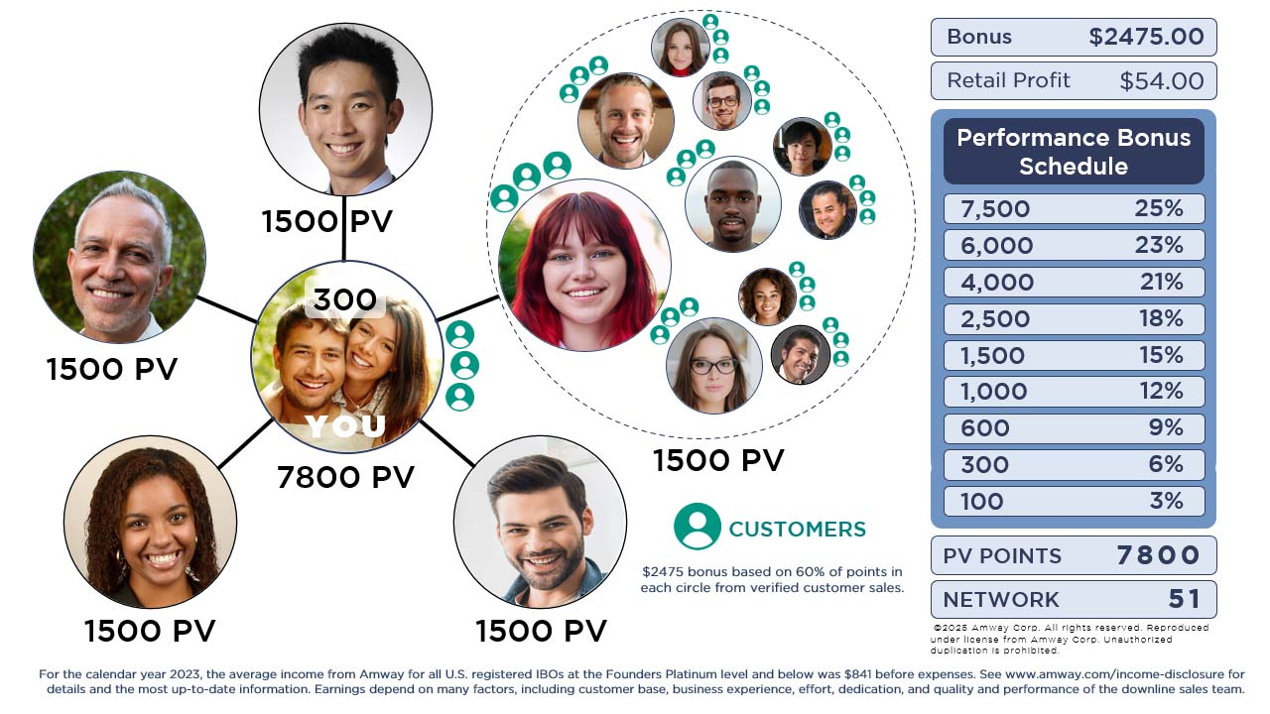
Notes:
As you expand your network, you increase your earning potential.
As I said at the beginning you can make a few hundred dollars a month to a few thousand dollars a month. The larger the network, the more income potential. It’s really up to you if you want to make a little extra or make it a business.

Slide 16
Notes:
These are just a few examples to help you understand how the business works and how the money is made. Just a reminder you don’t have to maintain inventory and there’s no commission for signing someone up. The only way to make money in this business is to help other people make money and through customer sales. Your coach has a vested interest in your success and will help you every step of the way.
Additional financial incentives are available. Some of which can be earned in your first few months in the business. Ask the person who invited you to tell you more about those.

Slide 17
Notes:
You don’t need any experience to be successful in this business.
Optional training is available through a company called Network 21.
Network 21 was started over 35 years ago and has trained hundreds of thousands of Amway business owners all over the world.
They operate in 39 countries and 24 languages providing training through a cutting-edge mobile app as well as in person and online meetings and seminars.

Slide 18
Notes:
Close
- With Amway you can start your own business with low risk, low costs and none of the stresses of traditional business and a satisfaction guarantee
- Your coach is here to support you and has a vested interest in your success
- With Network 21 you have access to business strategies and personal development from people who have been successful in this business all over the world.
You are in the right place at the right time.

